Slide 1

Big-Graph Analytics using Low-rank Approximations
Dimitris Papailiopoulos
UC Berkeley
· All audio is muted.
· If you dialed in, you MUST enter your audio pin to be able to ask questions!
· We recommend that you keep your phone muted, and unmute yourself when you need to ask questions
· You can view the upcoming seminar schedule at www.milibo.com/talent/events.aspx

Slide 2
Credits
Based on a series of results from joint collaboration with:
Ioannis Mitliagkas (UT Austin)
Alex Dimakis (UT Austin)
Constantine Caramanis (UT Austin)
And
Megas Asteris (UT Austin)
George Karystinos (TUC)

Slide 3
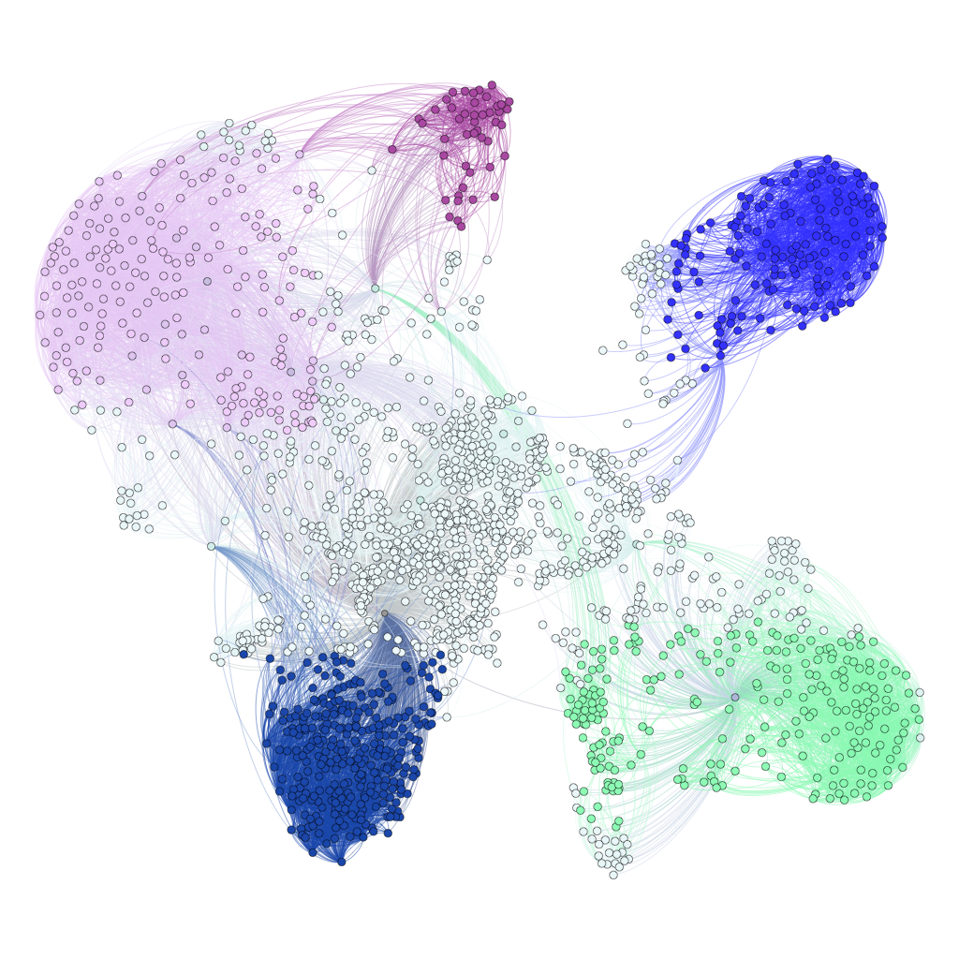
Dense Subgraphs

Slide 4
Community Mining
Social Network
ego-fb graph from
https://snap.stanford.edu
Drawn with gephi
Node: individual
Connection: friendship
Dense subgraph: community

Slide 5
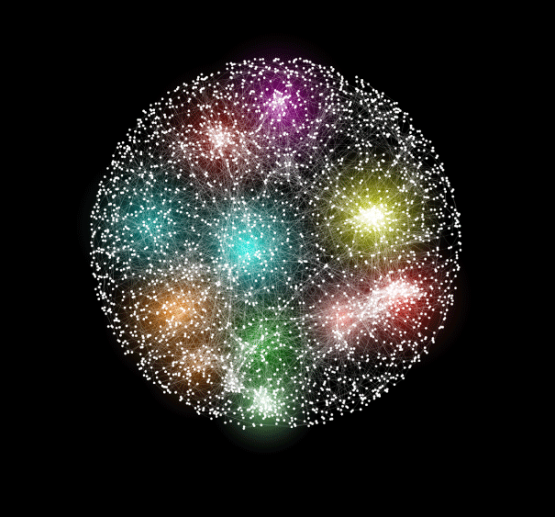
Patterns in Gene Networks
Credit: Anastasia Baryshnikova
http://www.genetics.org/site/misc/130765.xhtml
The genetic interaction network of yeast Saccharomyces cerevisiae.
Node: gene
Connection: gene similarity
Dense subgraph: genes with many common interactions

Slide 6
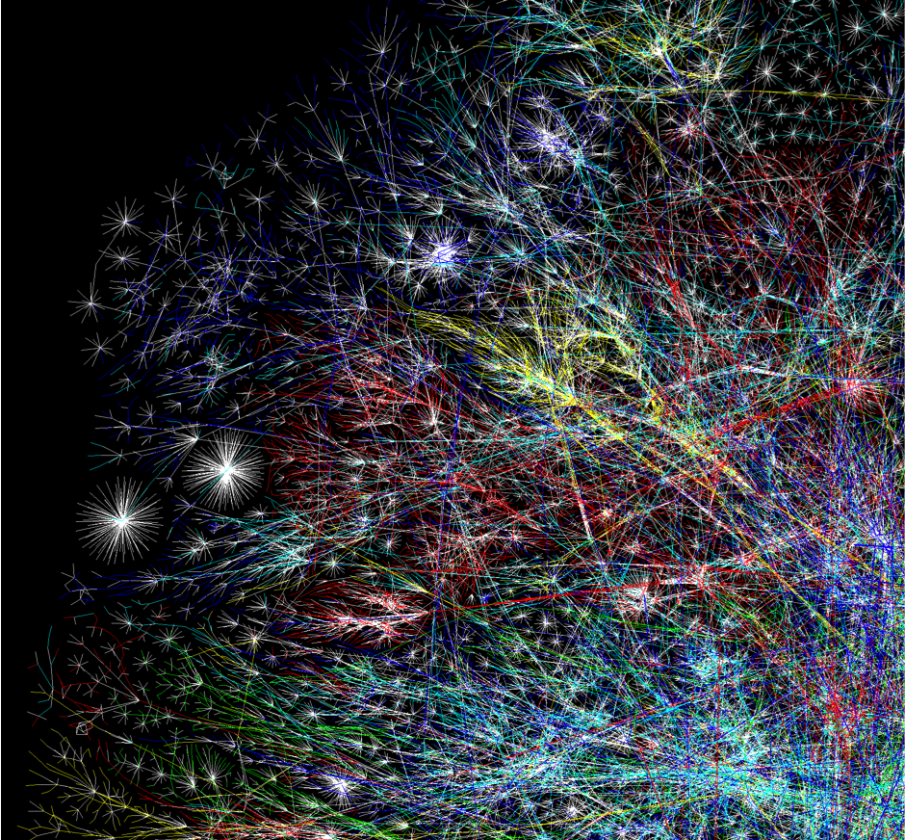
Spam Detection
The internet graph
Node: webpage
Connection: link from page to another
Dense subgraph: spam domain

Slide 7
Subgraphs and their density
Density(subgraph) = average degree
Notes:
-How to measure the density?
-def. the density of the subgraph = av.degree
-example

Slide 8
Subgraphs and their density
Density(subgraph) = average degree

Slide 9
Subgraphs and their density
Density(subgraph) = average degree
k = 4
Av.deg. = (3+2+2+1) / 4 = 2

Slide 10
Subgraphs and their density
Density(subgraph) = average degree
k = 4
Av.deg.= (1+1+1+1)/4 = 1
Notes:
-not well connected

Slide 11
Subgraphs and their density
Density(subgraph) = average degree
k = 5
Av.deg.= (2+3+3+2+1)/4 = 2.4
Notes:
-more connected, it’s similar to a clique, but it misses a few edges
-Higher average degree than previous

Slide 12
Density: a measure of inter-connectivity
Density(subgraph) = average degree
Average degree = 2*0/4 = 0
Average degree = 2*6/4 = k - 1=3
High-av.degree = very well connected (near clique)
Notes:
Density is a measure of how well connected are vertices
The two extreme cases
higher density, implies better well-connectedness

Slide 13
Densest k-Subgraph
Given a graph and a parameter k,
DkS: find the k vertices sharing the most connections with each other (max av.degree)
Here for k=5 there is a 5-subgraph with 10 edges (5 clique).
Q: Can you find it?
Notes:
The problem I am interested in solving, is called the DkS
find k vertices that share the most connections with each other
Something you can do: search all possible k vertices

Slide 14
Densest k-Subgraph (DkS)
Given a graph and a parameter k,
DkS: find the k vertices sharing the most connections with each other (max av.degree)
NP-hard
Hard to approximate
Here for k=5 there is a 5-subgraph with 10 edges (5 clique).
Q: Can you find it?
Notes:
This is a fundamental problem in graph theory, and theoretical computer science, that has been extensively studied
In general, it’s NP-hard, and hard to approximate
However, I still want to find dense subgraphs

Slide 15
Worst-Case Analysis
Notes:
There has been many algorithms for DkS, that come with provable guarantees.
So far the analysis setup is a worst case one.
I will be talking a bit about approximatoin algorithm, when we say that an algo is a rho approximation, it means that on input a graph, it outputs a k-subgraph that has density at least rho times that of OPT
In our little graph for example, that implies that the algorithm might nto be able to output the clique, but something that is at least rho dense. So rho closer to is better

Slide 16
Worst-Case Analysis
After long study, the best ratio [Bhaskara et al., STOC ’10]
10-factor approx for graphs with 10K nodes
100-factor approx for graphs with 100 Million nodes
(Ex: if densest k-subgraph has av.deg100, then approx has density >1)
Notes:
The problem has been extensively studied
After a series of deep theoretical results, the latest theoretical breakthrough comes from Bhaskara et al in a paper at STOC 10.
In their paper, they provide a new algorithm for DkS, that come with the following approximation ratio
The guarantee is that the k-subgraph that the algorithm finds, will have density a factor away from the optimal that grows as the number of nodes to the power of .25
Let’s see what that means for some graphs. Assuming…
So for example if the OPT solution has av degree 100, and I’m in the 100million regime of graphs, then the algorithm provably returns something with density at least 1.
So although theoretically these results are very useful, in practice they might be very tight

Slide 17
Known DkS guarantees under worst case analysis
might not be tight for practical settings
Q1: Provable, graph-dependent bounds?
Q2: DkS on billion-scale graphs?

Slide 18
Moving Beyond the Worst-Case
A new DkS algorithm with graph-dependent bounds:
Give me a graph, I run the algorithm, I tell you how far OPT is
In most tested graphs provably
Catch: our bound can be useless in the worst-case.

Slide 19
Moving Beyond the Worst-Case
A new DkS algorithm with graph-dependent bounds:
Give me a graph, I run the algorithm, I tell you how far OPT is
In most tested graphs provably
Scalable to billion-edge graphs
nearly-linear times for many real-world graphs
Parallelizable: implementation in MapReduce+Python
experiments up to billion-edge and million-node graphs
on 800 cores on Amazon EC2

Slide 20
Main idea of the algorithm

Slide 21
Eigenvalue decomposition of a graph
3
4
2
5
1
Eigenvalue decomposition
node
0 1 0 0 1
1 0 1 1 1
0 1 0 1 0
0 1 1 0 1
1 1 0 1 0
#nodes
node
What if we set the small ones to zero?

Slide 22
Low-rank approximation
1
1
1
1
1
1
1
So…
Low-rank graph is “close” to original…
Is this useful?
Rank-3 approximation
-.1
.8
1.1
.9
1.2
1.1
.9
.3
.8
-.1

Slide 23
Low-rank DkS Framework
1
Low rank approximation
via SVD
0.9
1
1.1
1
1.2
1.3
0.1
0.6
1
1
1
0.7
1.4
1
-0.2
-0.3
Can’t solve DkS
(in general)
DkS much easier on
low-rank graphs!
DkS on a graph
- Hard to solve
- Hard to approximate
DkS on constant rank graph
Nearly-linear time solvable (!)
Low-rank DkS related to original via spectral bound
Notes:
-Dks is hard on general graphs
- But things is much simpler for low-rank graphs, where we can compute a near optimal dense subgraph
- The interesting thing is that the best subgraph of the approximate graph, will be also a dense on the original graph, if the approximation is not very loose.

Slide 24
Is “low-rank” a good assumption?

Slide 25
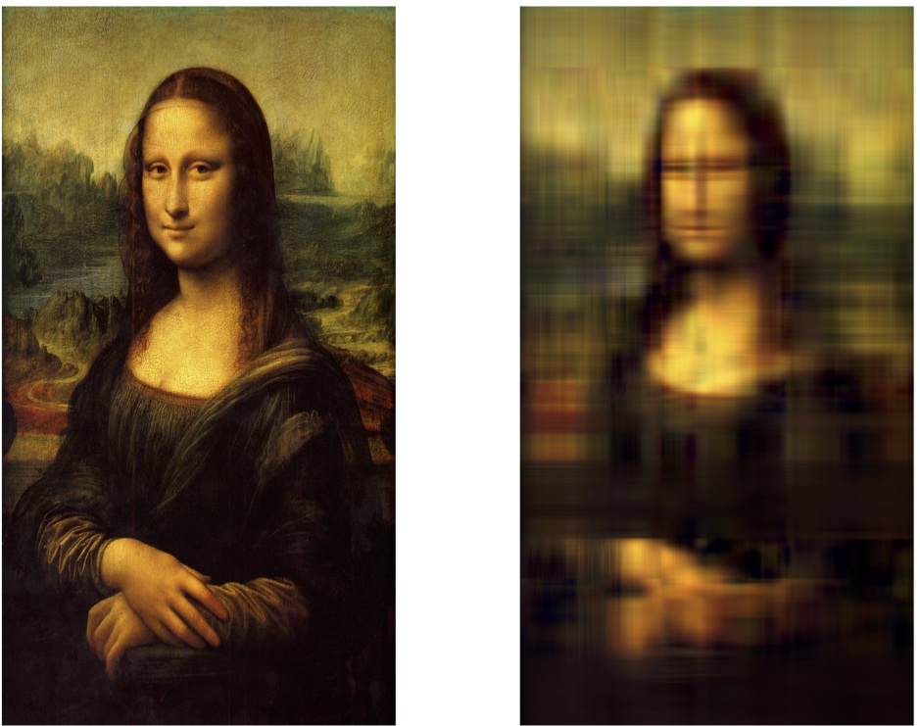
Is Real World Low-rank?
Real world is not Low Rank
Low-rank sparse PC is related to original sparse PC

Slide 26
Is Real World Low-rank?
Rank-7 Mona Lisa
Real world is nearly Low Rank!
Low-rank sparse PC is related to original sparse PC

Slide 27
Real Graphs can be nearly low-rank
Hope
nearly low rank => tight approximations
dblp network: 2 million connections
Power law decay ~ nearly low rank graphs
Low-rank sparse PC is related to original sparse PC

Slide 28
Graph dependent guarantees

Slide 29
Graph Dependent Guarantees
Thm 1:
Rank-d algorithm computes in a k-subgraph with density
You pick d: larger d => better approximation, slower execution (usually d <= 6)

Slide 30
Graph Dependent Guarantees
Thm 1:
Rank-d algorithm computes in a k-subgraph with density
Thm 2: If the largest d eigenvalues > 0 :
In time we compute a k-subgraph with density
You pick d: larger d => better approximation, slower execution (usually d <= 6)

Slide 31
Performance in Practice

Slide 32
Completely connected (clique)
Disconnected (no edges)

Slide 33
Completely connected (clique)
Blue: Tpower JMLR’13 Green: GreedyFeige Algorithmica ’01 Yellow: GreedyRavi OR ’94

Slide 34
Completely connected (clique)
Big Gap
Blue: Tpower JMLR’13 Green: GreedyFeige Algorithmica ’01 Yellow: GreedyRavi OR ’94

Slide 35
Completely connected (clique)
Rank-1 approximation
Blue: Tpower JMLR’13 Green: GreedyFeige Algorithmica ’01 Yellow: GreedyRavi OR ’94

Slide 36
Completely connected (clique)
Rank-2 approximation
Blue: Tpower JMLR’13 Green: GreedyFeige Algorithmica ’01 Yellow: GreedyRavi OR ’94

Slide 37
Completely connected (clique)
Rank-5 approximation
Blue: Tpower JMLR’13 Green: GreedyFeige Algorithmica ’01 Yellow: GreedyRavi OR ’94

Slide 38
Completely connected (clique)
Smaller Gap
Blue: Tpower JMLR’13 Green: GreedyFeige Algorithmica ’01 Yellow: GreedyRavi OR ’94

Slide 39
OPT can’t be better than this
(spectral bound)
80% OPT
Blue: Tpower JMLR’13 Green: GreedyFeige Algorithmica ’01 Yellow: GreedyRavi OR ’94

Slide 40
Theory

Slide 41
DkS via Quadratic Optimization
vertex
vertex

Slide 42
DkS via Quadratic Optimization
vertex
Edges
In subgraph
vertex

Slide 43
DkS via Quadratic Optimization
vertex
Edges
In subgraph
vertex

Slide 44
DkS via Quadratic Optimization
vertex
vertex
Edges
In subgraph

Slide 45
DkS via Quadratic Optimization
vertex
Edges
In subgraph
vertex
DkS:
Find the k-by-k submatrix with most 1s

Slide 46
DkS via Quadratic Optimization
vertex
Edges
In subgraph
vertex
DkS:

Slide 47
DkS via Bilinear Optimization
Why?
analysis works for bilinear
but…
Lem: The solutions have a gap of at most 2
DBkS:
DkS:

Slide 48
A low-rank DkS framework
When the graph itself is not low-rank:
Compute : a rank-d approximation via SVD
Solve on
obtain guarantees.
* When the d largest eigenvalues of the adjacency are positive, and have constant gap
Low-rank DBkS:
We can solve it in time
*Under mild conditions, we essentially solve it in

Slide 49
Low-rank algorithm

Slide 50
How the algorithm works for rank-1
Rank-1 case:
Q: Maximize the inner product of two vectors?
Ex, n = 4, k =2 :
A: find the k largest elements of v

Slide 51
The simple intuition of Rank-1
Def: top-k set: the k-largest cordinates of a vector,
e.g., if k =2, then top-2 set = {3,4}
Intuition: x picks the top-k set of v.
1 2 3
4

Slide 52
Rank-2?
Intuition: x picks the top-k set of a vector from a 2-dimensional span.
1
2
3
4
5
2
7
0
Q: How many top-k sets do we need to check in a 2-dimensional span?
[Asteris, P., Karystinos, 2011] (exact solver)
Theorem: # top-k sets we need to check = O(n^d)

Slide 53
Rank-2?
Intuition: x picks the top-k set of a vector from a 2-dimensional span.
Via constructing ε-nets (i.e., a grid of points)
1
2
3
4
5
2
7
0
Q: How many top-k sets do we need to check in a 2-dimensional span?
(ε-error solver)
Theorem: # top-k sets we need to check (for an error ε) = 1/ε^d

Slide 54
Low-rank DkS:
SVD

Slide 55
Low-rank DkS:
SVD

Slide 56
Low-rank DkS:
SVD

Slide 57
Low-rank DkS:
SVD
(a k-subgraph)

Slide 58
Low-rank DkS:
SVD

Slide 59
Low-rank DkS:
SVD

Slide 60
Low-rank DkS in MapReduce

Slide 61
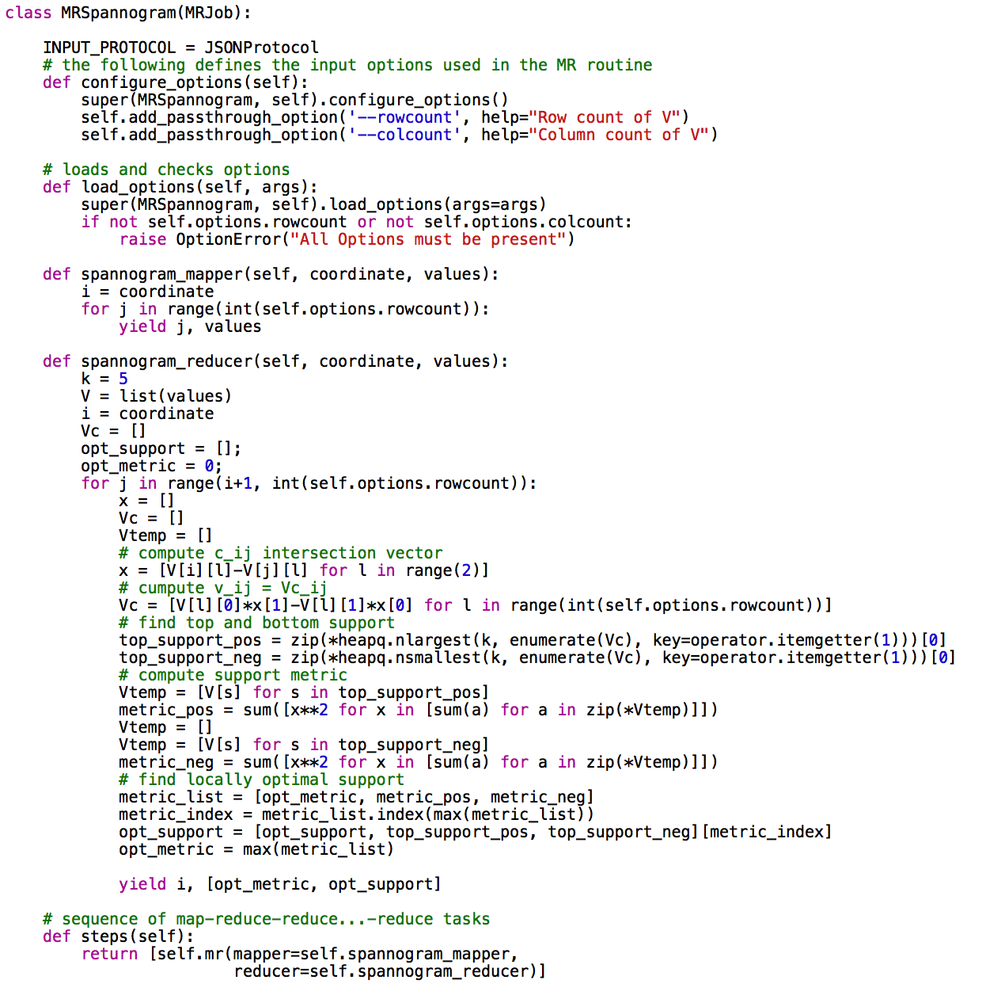
Mapreduce Implementation

Slide 62
Billion-scale Graphs
Graph fits in RAM
Parallel
Implementation
UP to 800 cores
On EC2
Note:
SVD was
bottleneck

Slide 63
Conclusions
A new spectral approximation algorithm for DkS.
Graph-dependent spectral bounds:
OPT within 70% in most experiments.
Our bound could be trivial in the worst case.
Empirically outperforms previous state of the art

Slide 64
Open Problems
Q1: Other analytics that fit the low-rank approach?
Triangles, Cuts, spanning trees, flows,..?
(general theory)
Q2: When are low-rank graphs good sketches for general graphs?
Q3: GPU vs. MR vs. GraphX?

Slide 65
the end

Slide 66
Experiments

Slide 68
Rank-2 Spannogram
Theorem:
We can solve the rank-2 DkS, by checking all top-k sets in the span of
Ok, let’s check all coefficeints a and b, and find all top-k sets in
Wlog c = [a, b] is unit norm.
A [a, b] point maps to:
a
maps to a k-subgraph
0
b
Scan all points and keep
the best k-subgraph

Slide 69
Rank-2 Spannogram using ε-nets
Def:
N(ε) is ε-net of S, if for any point in S there exists a point in N(ε) that is ε-close
A [a, b] point maps to:
a
maps to a k-subgraph
0
b
Scan all ε-net points and keep
the best k-subgraph
Q: how many points to sample?
Theorem:
A net of size 1/ε^d suffices for a 1+ε approx. of the rank-d DkS
Efficient + parallelizable ε-net construction in time O(1) per point:
use information theory tools from the 70’s

